Slide 1
Pattern Stream & Capture
Preliminary specification
By Alex Sukmanov

Slide 2
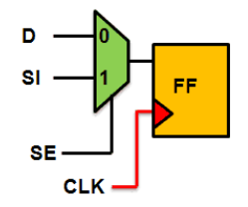
Overview
Pattern Stream & Capture (PSC) block is a part of ASIC verification automated system runs on FPGA.
Every type of ASIC in our company has scan chains integrated in the silicon. This scan chain testing method can easily detect faults like shorts and opens.
Basic scan chain element Fig1 consists of Multiplexer connected to Flip-Flop.
Where:
D - functional input
SI – Scan In input
SE – Scan enable signal
CLK – system clock
Fig1. Scan chain Flip-Flop

Slide 3
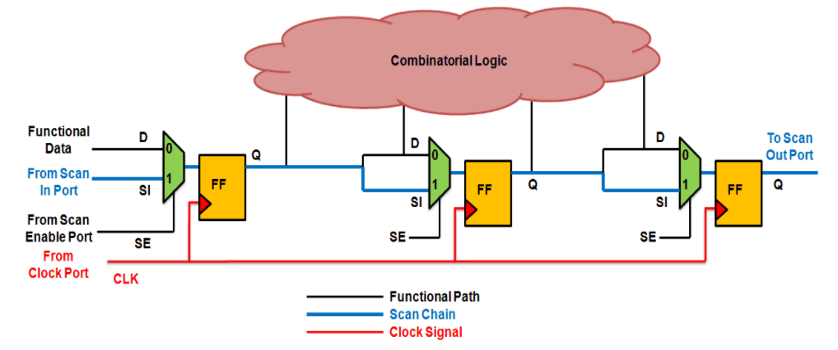
Overview - continued
Using this basic Scan Flip-Flop as the building block, all the flops are connected in form of a chain, which effectively acts as a shift register.
The first flop of the scan chain is connected to the scan-in port and the last flop is connected to the scan-out port.
Scan testing is done in order to detect any manufacturing fault in the combinatorial logic block. In order to do so, test vector shifted in via input ports and shifted out data checked versus expected values generated with the test vector.
Fig2. Scan chain Flip-Flop

Slide 4
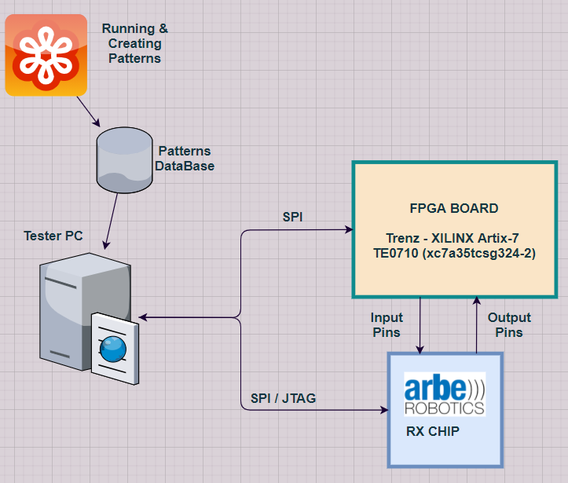
System overview
Features
Creating offline patterns via ATPG/Simulation
Create STILL pattern format
InsightTest convert to target format
(format which will fed into FPGA)
Functional Tests:
PC can connect directly via SPI and JTAG
Pattern Tests:
PC will load pattern to FPGA via SPI and control the FPGA state machine
FPGA:
Receive and Store pattern
Capture output pins
Manage Tester state machine
Optional pattern checker

Slide 5
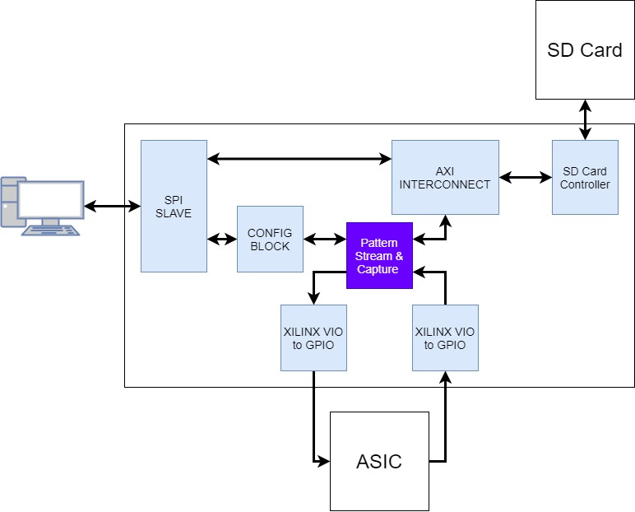
System Block Diagram

Slide 6
Requirements (High Level)
There are 2 modes of operation:
A. Captured pattern is saved to memory, Stream & Capture block doesn’t check the pattern. In this mode, the Read port is used to get the Stream Pattern & the Write port is used to send to the memory the Captured pattern.
B. Captured pattern isn’t saved to memory, but it’s checked by the Stream & Capture block to expected pattern. In this mode, the Read port is used to get both Stream & Captured patterns. The Write port is used to send info on the failures if any (i.e., in what capture cycles the pattern check failed).
Upon “go” the Stream & Capture block should read pattern from the FPGA memory & stream it towards the ASIC. In parallel, it should capture the pattern that it gets back from the ASIC.
When the configured size ends (all pattern was streamed), the Stream & Capture block should provide “Finish” indication together with the pattern check status (in operation mode B)

Slide 7
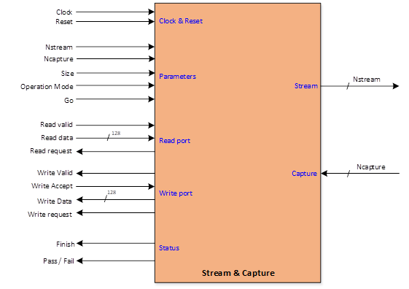
Requirements (Debug) & Black Box
Stream & Capture block should use internal ILA with test probes as required for debug support
Stream & Capture block should support mode in which known (generated internally) pattern is streamed

Slide 8
IO’s description
Clock - 100 MHz clock
Reset - Asynchronous active low reset
Nstream, Ncapture - generic parameter that stands for Stream/Capture vector’s width
Size – input from configuration block that stands for test vector’s depth. (Can be modified “on fly”
Operation Mode – configure operation mode of the block ( A/B/Test mode)
Read request – request to memory controller to read next test vector cycle.
Read Valid – flag from memory controller that next test vector cycle can be registered
Read Data[127:0] – parallel bus to read data from memory.
Write Request – request to memory controller to write captured data from Asic
Write Accept – flag from memory controller that memory available to write.
Write Valid – flag to memory controller that data is valid to write
Write Data[127:0] – parallel bus to write data to memory.
Finish – “ready” flag means that PSC block finished to stream and to capture patterns.
Pass/Fail – flag that stands if test passed or failed.
Stream[Nstream-1:0],Capture[Ncapture-1:0] – ports for ASIC’s pins stimulus and data capture.

Slide 9
Global - Flow
RSTN = 0
IDLE
ELSE
I_GO = 1 AND I_OP_MODE = 00
I_GO = 1 AND I_OP_MODE = 10 OR 11
I_GO
AND I_OP_MODE
I_GO = 1 AND I_OP_MODE = 01
MODE_A
MODE_B
TEST_MODE
WRITE_CNT
<
SIZE?
NO
WRITE_CNT
<
SIZE?
NO
WRITE_CNT
<
SIZE?
NO
YES

Slide 10
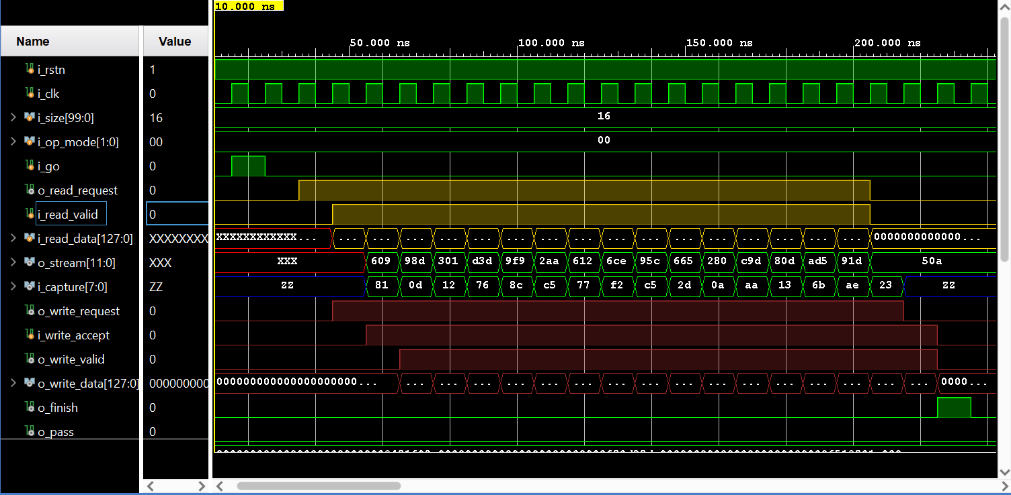
MODE_A - Waveforms
STOP BIT
START BIT
Capture and WRITE to Memory process
READ from Memory and Stream process

Slide 11
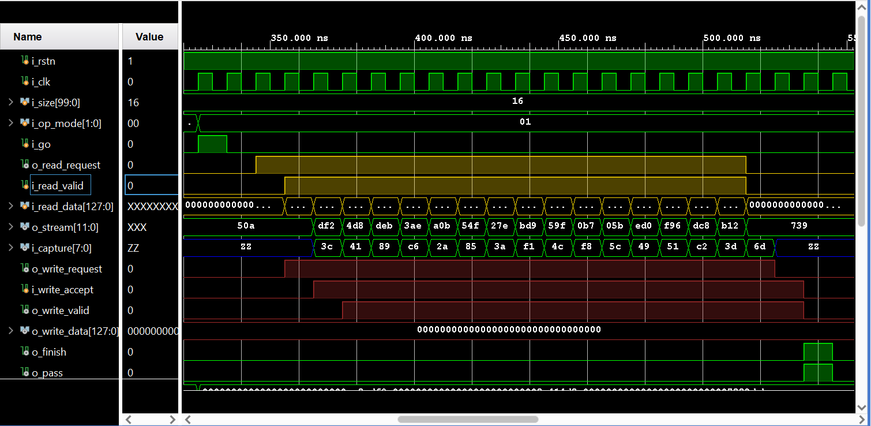
MODE_B - Waveforms
STOP BIT
PASS BIT (if were no errors)
START BIT
Capture and WRITE to Memory process
READ from Memory and Stream process

Slide 12
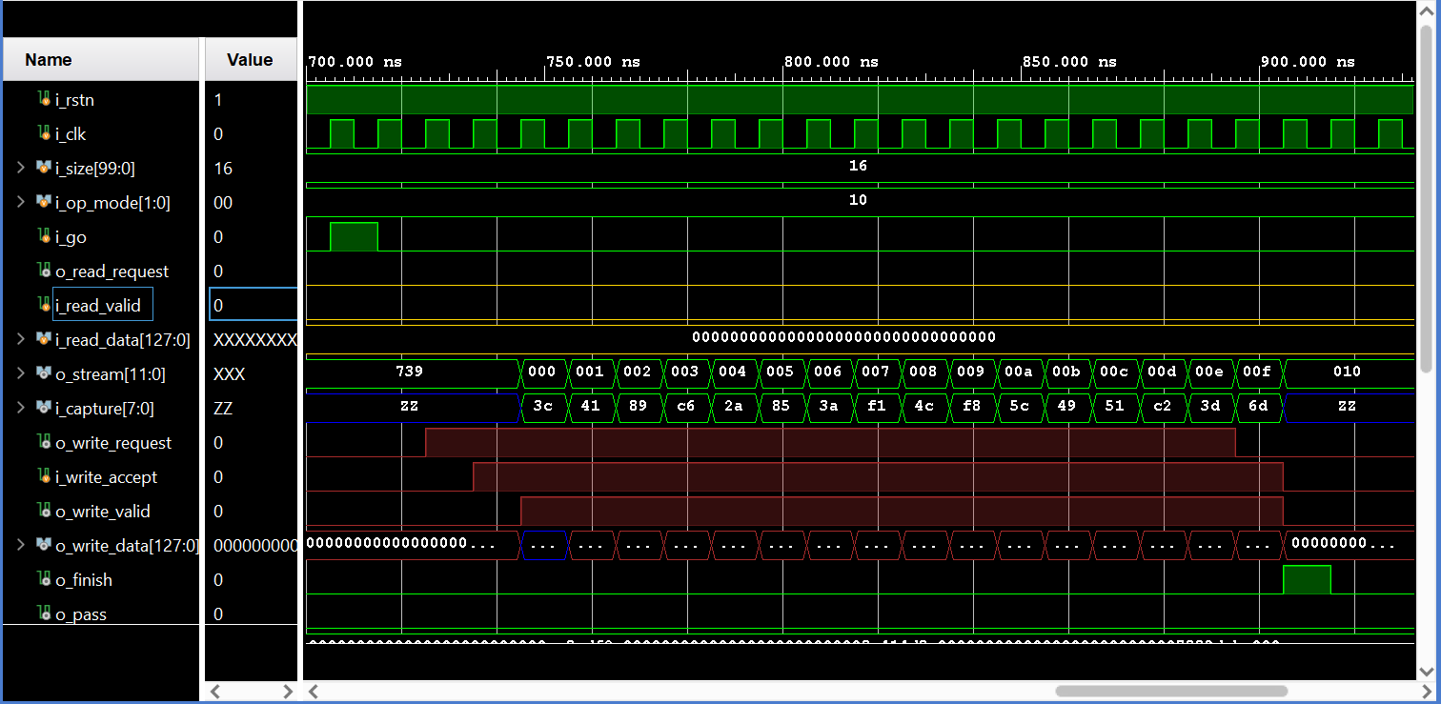
TEST_MODE- Waveforms
STOP BIT
START BIT
Capture and WRITE to Memory process
Known Test vector generation and Stream process

